Slide 1
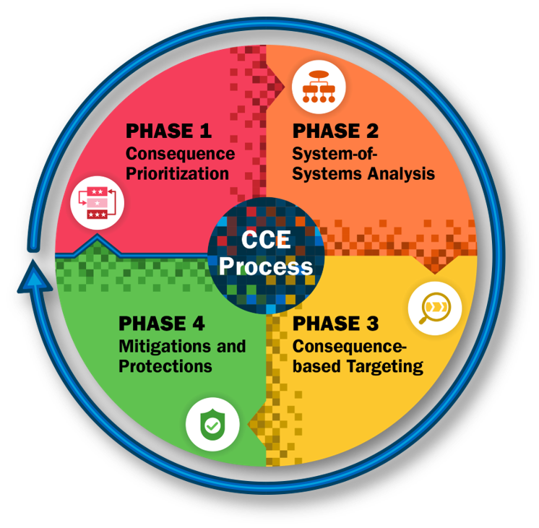
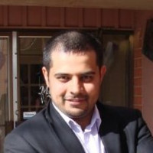
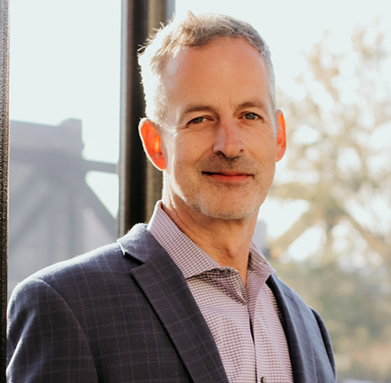
Countering Cyber Sabotage: Introducing the Consequence-driven Cyber-informed Engineering (CCE) Methodology
Prashant Andrew Bochman
Linkedin: https://www.linkedin.com/in/prashantprofile/
Twitter: @prashant_geek
YegSec Slack: @guy_fawkes
Disclaimer: The views, thoughts, and opinions expressed in the talk belong solely to the author, and not necessarily to the author's employer, organization or any committee.

Slide 2
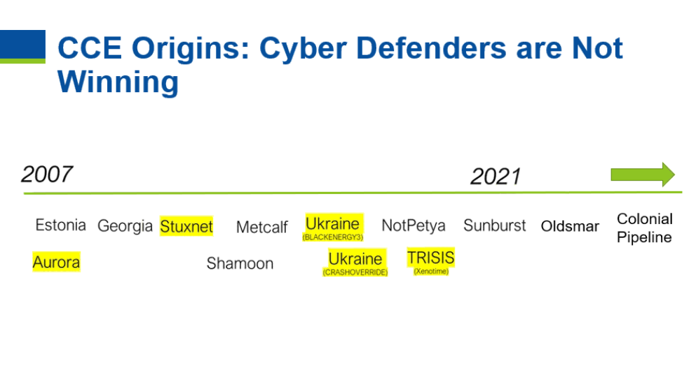

Slide 3
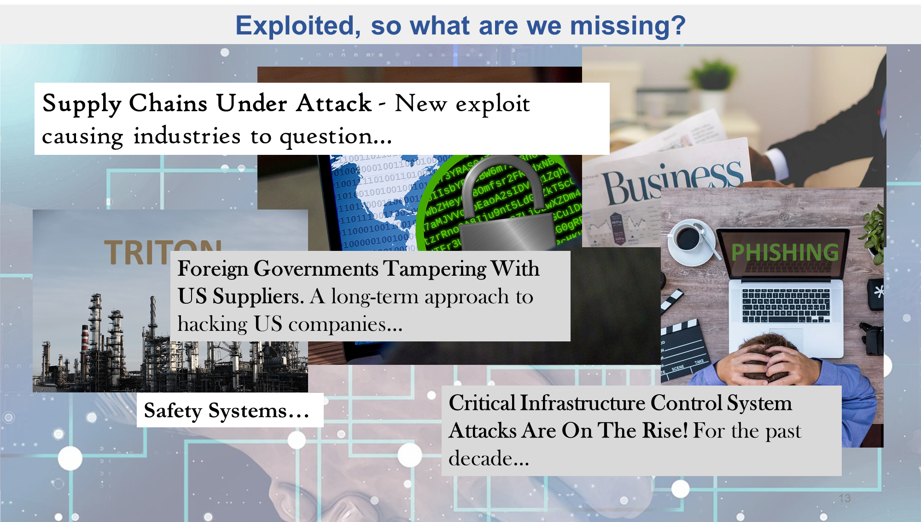
Exploited – what are we missing?
Notes:
Let’s take a few minutes to examine why you are here, why we want you to learn and adopt a new approach to protecting our critical infrastructure.
As you all know, we continue to be attacked and exploited.
This despite having the latest and greatest operational and security technologies for: controls, communications, network monitoring, endpoint protection, access control, vulnerability identification, asset management, logging, alerting as well as mapping of known/common TTP (techniques, tactics, procedures) for certain threat actors or groups.
So, what can help us in our security approach?

Slide 4
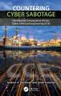
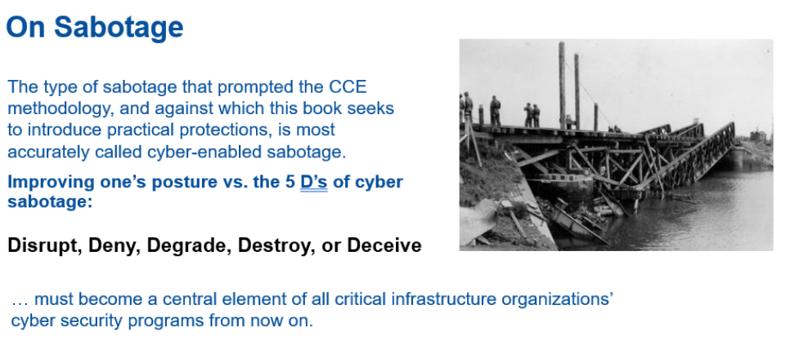
Cyber-enabled Sabotage

Slide 5
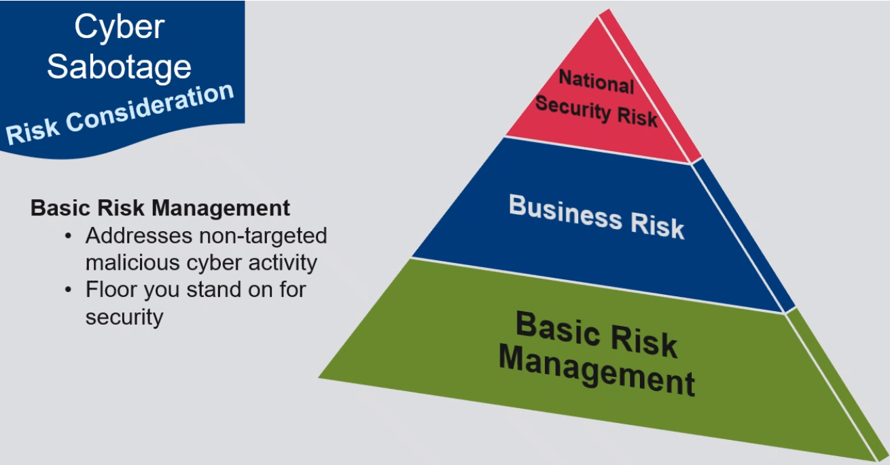

Slide 6
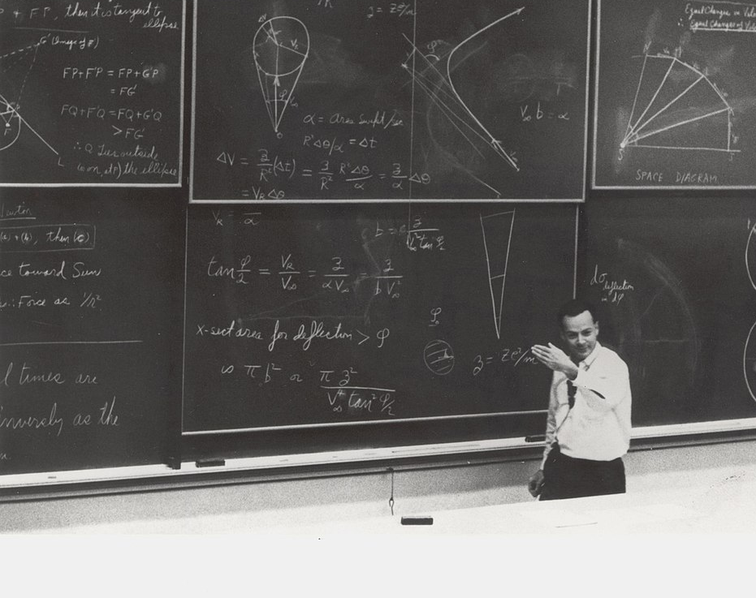
Cyber Defenders spend big time and money calculating LIKELIHOOD

Slide 7
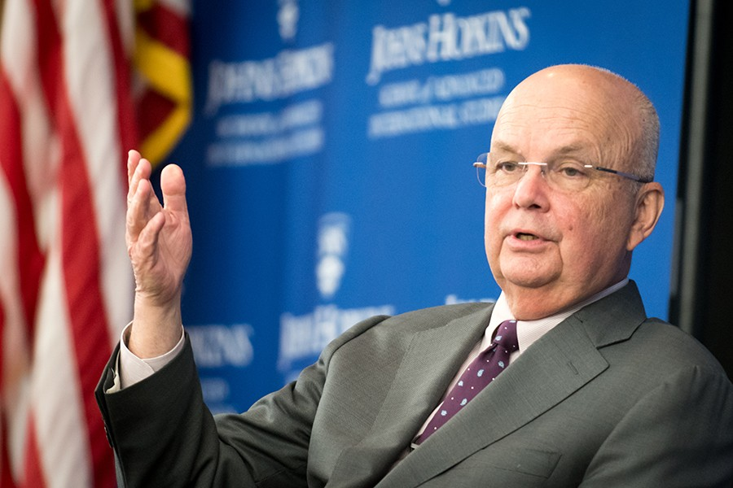
Can You Handle the Truth?
“They’re going to get in, get over it.”
– Michael Hayden

Slide 8
Supply Chain
Vendors
Think Different
Think Like the Best Adversary
System
People
Network Based Attacks

Slide 9

Critical Functions
The actions or activities that make up the organization’s primary mission or purpose.
Notes:
Χριτιχαλ φυνχτιονσ αρε τηε αχτιονσ ορ αχτιϖιτιεσ τηατ μακε υπ τηε οργανιζατιον’σ πριμαρψ μισσιον ορ πυρποσε.
One of the key functions working for a natural transmission pipeline as an automation engineer is moving bulk natural gas
You may work for companies or organizations with similar Critical Functions – electric power gen and transmission, oil and refined liquids transport, etc.
We could also be talking about communications/data services (voice, Internet services), water (treatment, distribution), etc.
This is an important and unique starting point for protecting our CF.
Notice that it provides an immediate focus and prioritization of our efforts to protect what is most valuable to our organization.
This is in contrast to a traditional approach of beginning with tech deployment, architectures, etc.
We get to that next. But only after we have prioritized the functions that mean the most.

Slide 10












Critical & Enabling Functions
Critical Functions
Enabling Functions
People
Infrastructure
People
Processes
Technologies
Notes:
The adversary can impact our Critical Functions by targeting the enabling functions required to carry out a critical function.
What do we mean by that?
The infrastructure, people, process, technology (PPT), and systems (or often systems of systems) the entity uses to both logically and physically deliver those Critical Functions. We can call these Enabling Functions (EF).
Key words: logically and physically deliver.
Enabling Functions are not only technology – they include:
• Technologies (hardware, software, firmware, comms, security platforms, etc.)
• Deployment (configuration, dependency – client/server, arch., etc.)
• Operation (processes/procedures, manual/automated)
• Support (internal, external, supply chain, integrators)
For each entity/organization - components often common but implementation is unique.
For us as defenders, the challenges begin here: CF Delivery = EF is Complex.
Let’s take an example from the energy sector – a natural gas-fired, combined cycle power plant. Why does this plant exist: Critical Function (CF) = Electrical power generation.
Question: How is the CF “delivered”? How is the power generated?
Its complex: 5 primary systems and 96 subsystems.
• Topping Cycle - gas turbine and its dedicated systems.
• Bottoming Cycle - steam turbine, HRSG, condensate, feed water, associated systems.
• Heat Rejection - Systems that reject heat to the environment.
• Electrical - Systems that export power to the grid or supply power to plant equipment.
• Plant Integration - Systems that support power train equip in converting fuel to electrical power.
Each will have layers of Operational/Security Technologies plus Deployment, Operations and Support functions and processes. - From an adversary targeting (or defenders) perspective – can you imagine any dependencies or potential risks to electricity generation inherent in the implementation of 96 subsystems? Current events: Water delivery systems in Texas gas-
fired combined cycle gen plants…Could the water systems withstand human exploitation?
Enabling Functions = Delivery. We need to recognize and understand (at an engineering level) the complexity inherent in our delivery. If not, we are sustaining unnecessary risk and providing “blind spots” for adversary to take action. Its possibly “security through obscurity” FOR THE adversary!
Let’s look at an additional, often missed aspect of EF.

Slide 11
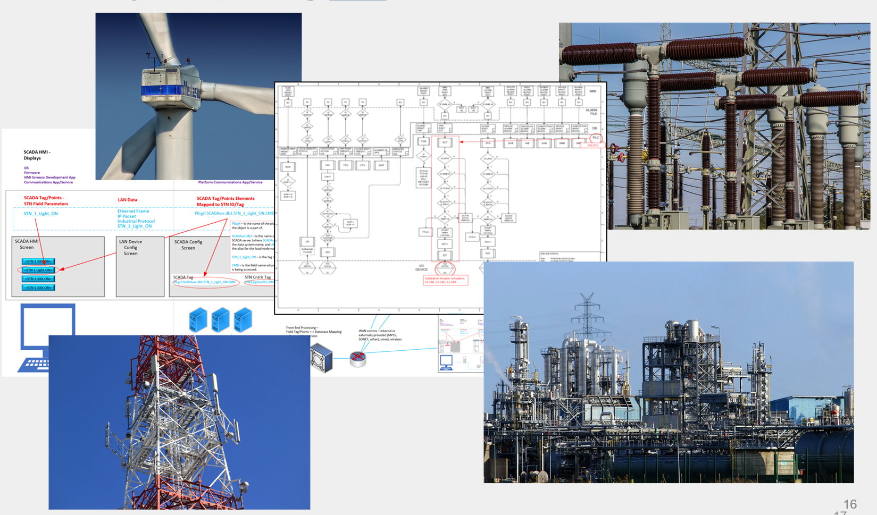
An adversary exploits our Enabling Functions AND impacts our Critical Functions.
Exploiting how we deliver our critical functions.
Notes:
Image source Pixabay, accessed on 4/2/2021 – queries performed: ‘Refinery’ ‘power plant’ ‘substation’ ‘communications’
We previously stated that the adversary accomplishes their goal by exploiting our delivery of those Critical Functions.
Here’s where we get to the tech and more.
For each entity/organization - components often common but implementation is unique.
For us as defenders, the challenges begin here: CF Delivery = EF is Complex.
We need to recognize and understand (at an engineering level) the complexity inherent in our delivery. If not, we are sustaining unnecessary risk and providing “blind spots” for adversary to take action. Its possibly “security through obscurity” FOR THE adversary!
Its not just the level of complexity inherent in getting work done, the business model has also changed.
Back in the day everything was built in-house (board, code, etc.) and controlled
Organizations commonly outsourced/subcontracted the development, support services, etc.
Footprint of entity is now every vendor and subcontractor you employ (the attack surface significantly larger today than in years prior)
Organizations have outsourced many critical roles (engineering, maintenance, etc.) and have come to trust a convergence of information technologies with operational technologies (e.g., sensors, motors, valves, programmable controllers, communications networks) to provide electricity, water, and other critical needs. a. This is due, in part, to an outdated assurance that we fully understand and have full control over critical processes and functions.
In decades past, the source of a device or technology could be traced directly to each individual involved with its design, engineering, and development.
Today, myriad of individuals, companies, and services across the world may be involved in the delivery of a single device. The design and integration of contemporary industrial operations include unverified trust at multiple levels.
As a result, we have opened the door to cyber-enabled sabotage intended to cause devastating physical consequences at a time of the adversary’s choosing.

Slide 12
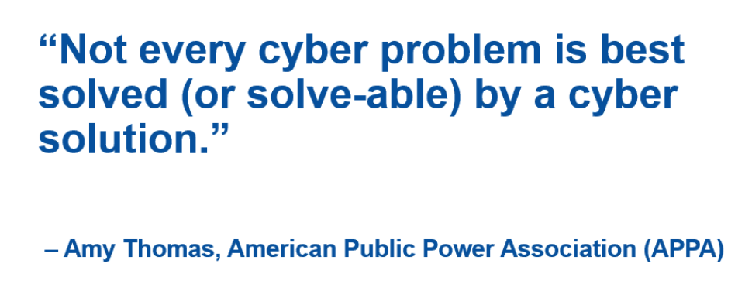
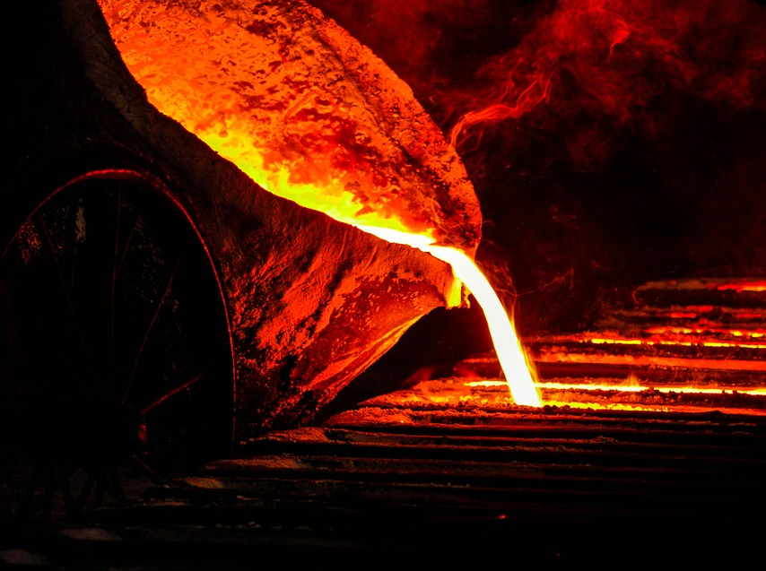
German Steel Mill Hack
Notes:
Function Provided:
Integrated Steelworks produce strip steel.
Although we do not know the exact location or name of the steel mill, the production of steel is considered essential for most modern nations as it directly supports several major industries.
Security Mindset:
Benjamin Sonntag, a software developer told Reuters: "We do not expect a… steel plant to be connected to the internet... To be computerized, but to be connected to the internet and to be hackable - that is quite unexpected," he said.
High Consequence Event:
December 2014, the operators of industrial plants were specifically targeted.
Various plant controls failed; the furnace was unregulated causing permanent damage to the steel plant.
According to BSI, the attackers used spear-phishing and social engineering tactics to obtain usernames and passwords for the production control network.
The internet-facing network was then bridged with the industrial control network.
The attackers showed familiarity with both conventional IT security systems but also the specialized software used to operate the plant.
Sabotage Effect:
This destruction was the result of an accumulation of individual control components breaking down.
The furnace was unable to be shut down properly, causing millions of dollars worth of damage to the hardware.
Fortunately, no human casualties were sustained.
Lesson Learned:
“The most significant component of this report is the demonstrated capability and willingness of an adversary to attack through traditional advanced persistent threat (APT) style methods and then advance to a cyber-physical attack with the intent to impact an operational environment” – SANS report “German steel mill cyber attack”
Image Source: https://pixabay.com/photos/iron-melt-furnace-metal-hot-fire-900391/
References:
https://www.industrialcybersecuritypulse.com/throwback-attack-a-cyberattack-causes-physical-damage-at-a-german-steel-mill/
https://cyberlaw.ccdcoe.org/wiki/Steel_mill_in_Germany_(2014)#cite_note-2
https://www.bbc.com/news/technology-30575104

Slide 13
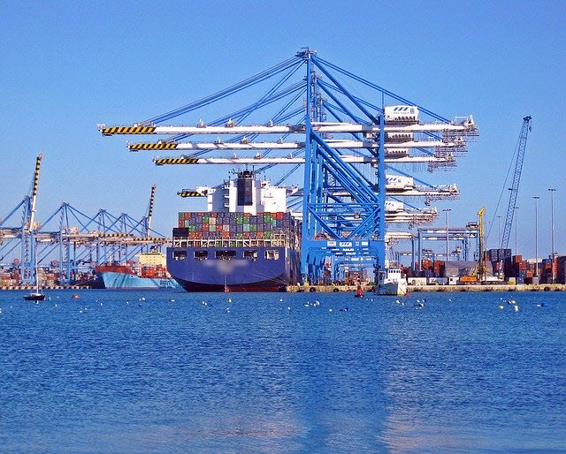
Enabling Functions:
Maersk
Notes:
Function Provided:
A Maersk ship docks somewhere in the world every 15 minutes, unloading between 10,000 to 20,000 containers.
Maritime giant, responsible for 76 ports and a massive fleet of container ships carrying tens of millions of tons of cargo. Representing 1/5th of the entire world’s shipping capacity. Largest container shipping company in the world since 1996.
Their IT infrastructure contained all of the ships’ inventory files (for ~18,000 container vessels).
Ocean transport, inland services, intercontinental rail, and air freight.
Dry cargo, refrigerated cargo, special cargo, and dangerous cargo
Security Mindset:
Better than industry standards IT posture.
Achilles Heel: Did not consider potential consequences of having several functions relying on a single (albeit robust) network.
Server Backups:
Almost all of Maersk’s individual servers were successfully backed up with data less than 1 week old.
Domain Controller Backups:
Maersk arranged roughly 150 domain controllers into a decentralized backup strategy by programming them to sync with each other. This allowed them to rebuild individual or multiple domain controllers if they were lost. However, this strategy did not prepare the company for recovery if all domain controllers were lost, because no external backup existed.
Luckily, one single domain controller had been knocked offline in Ghana before the attack due to a power outage, and it was eventually used to rebuild the domain infrastructure.
High Consequence Event:
Maersk’s business network was infected with NotPetya. It spread throughout their entire network and forced Maersk to completely halt operations because they were completely reliant upon the information on their databases. Their ability to efficiently coordinate shipping efforts, or even know what each vessel contained as it sat in a harbor, was completely removed for weeks.
NotPetya appears to be ransomware and looks similar to Petya from 2016. But NotPetya’s ransom demands are only used as a distraction from the actual attack, giving the code time to spread and encrypt files. The malware was only designed for destruction. The encrypted boot records were not recoverable and ransom payments did not work because no key existed.
Sabotage Effect:
It was over 1 week before the shipping company’s terminals were functioning again.
All of the workstations, laptops, and servers had to be wiped completely – so all files saved to individual machines were lost. In total, Maersk had to replace approximately 4,000 servers and 45,000 PCs.
While waiting for the network to be rebuilt, employees were forced to use whatever resources they could find to accomplish their jobs in the meantime. Many of the documents were physically taped to the shipping containers during that time, and employees had to use personal Gmail accounts to conduct business.
One of Maersk’s customers said “I can tell you it’s a fairly bizarre experience to find yourself booking 500 shipping containers via WhatsApp, but that’s what we did.”
Total cost was approximately $300,000,000.
Unintentional destruction – actual target was probably somewhere in Ukraine.
Lesson Learned:
Maersk’s chairman, Jim Hagemann Snabe, warned that in the near future, as automation creates near-total reliance on digital systems, human effort won't be able to help such crises. He further noted that the internet was not designed to handle the variety of applications that constantly rely on it. He also called for all businesses to stop being naïve about security, and said that organizations of any size - even the mightiest - will experience disruptions if they don't take security seriously.

Slide 14
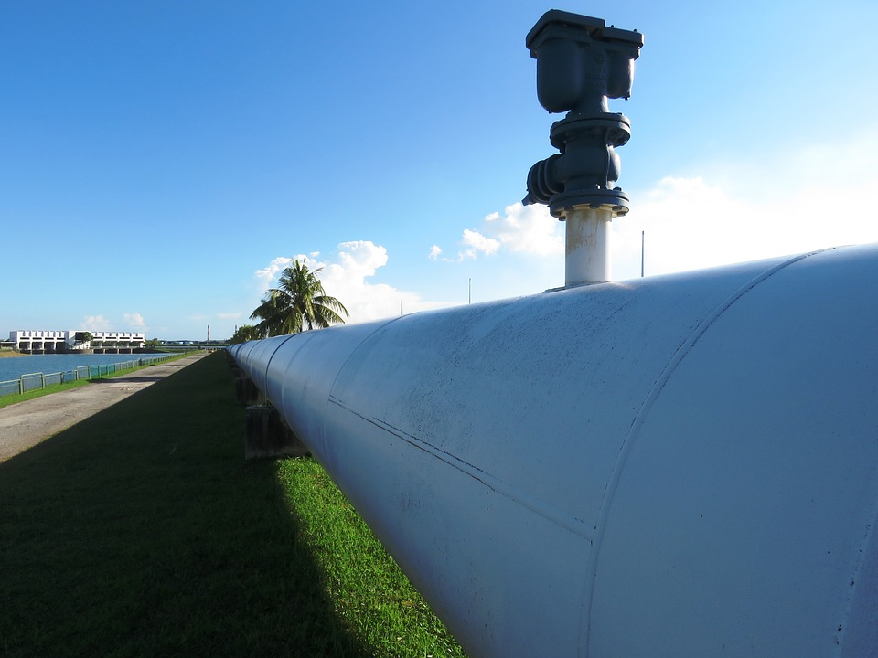
Impact:
Colonial
Notes:
Function Provided:
Largest pipeline system in the U.S. for refined oil products, averaging 100 million gallons of product per day between Texas and New York.
Security Mindset:
After the events of 9/11/2001, Colonial Pipeline increased physical security at all their facilities and created a comprehensive plan.
The federal government used Colonial’s protections as a model for the entire pipeline industry – but many cyber concerns were not understood or addressed at that time.
High Consequence Event:
5-day shutdown after the company was hit with ransomware in their business network.
Gas prices skyrocketed, and many organizations asked their employees to avoid driving to work to help save fuel.
Sabotage Effect:
The result was mostly financial for Colonial, but their reputation was also called into question due to their handling of the ransomware attack.
The East Coast of the United States was left without its major artery for petroleum products.
Lesson Learned:
Placing data required for operations on business networks comes with several risks.
Although the control system may be segmented and able to deliver products, if the processes rely on external information that is removed, the process halts.
Image Source: https://pixabay.com/photos/pipeline-oil-flow-oil-industry-2472068/

Slide 15
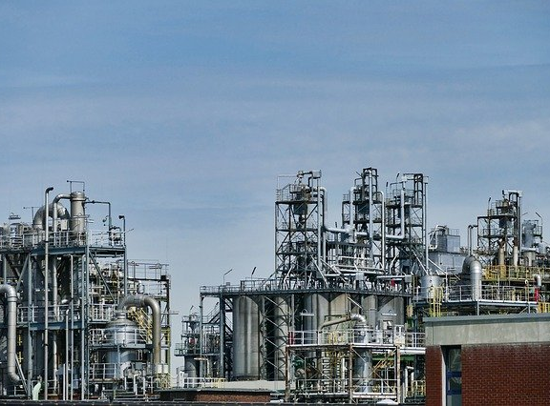
Triconex SIS Malware
Notes:
Functionality Provided:
Designed to be the true backstop to prevent high consequence events from occurring despite human error and mechanical malfunctions.
Security Mindset at the time
Generally considered to be unassailable. These were viewed as a third tier
The assumption of security was so strong, that many indicators were not caught
This example is unique:
No actual HCE occurred – but several are now open for discussion as a result
Upon discovery they stated that the attack was not scalable because of an operator error (switching to programming mode).
Represents a first peek at the concept that “NO TECHNOLOGY that we implement into our operations can be assumed to be safe.”
This leads to one of the CCE baseline assumptions “The Adversary has physical, logical access.”
Tip of the Ice Cube
Indicators and artifacts found at the time
The observed instance of this
What was the intent of this attack/research?
[INSERT SOME BLURBS FROM SYMANTIC]
…believes this was intended to cause damage…
[INSERT BLURB FROM MIT TECHNOLOGY REVIEW]
…world’s most murderous malware
Cause a shutdown? Regular access to a control system
At face value the TRISIS malware appears to be intended for harm and destruction (e.g., explosions).
Safety Systems may also be targeted for other purposes – it is a blind spot to many operators because they are trained to trust this type of system.
Now that these systems, which are so redundant and
IT/OT convergence is too simplistic – Safety Systems formed something of a 3rd tier of systems.
Detection of this shows the lengths and depths that an adversary will go to when developing the

Slide 16
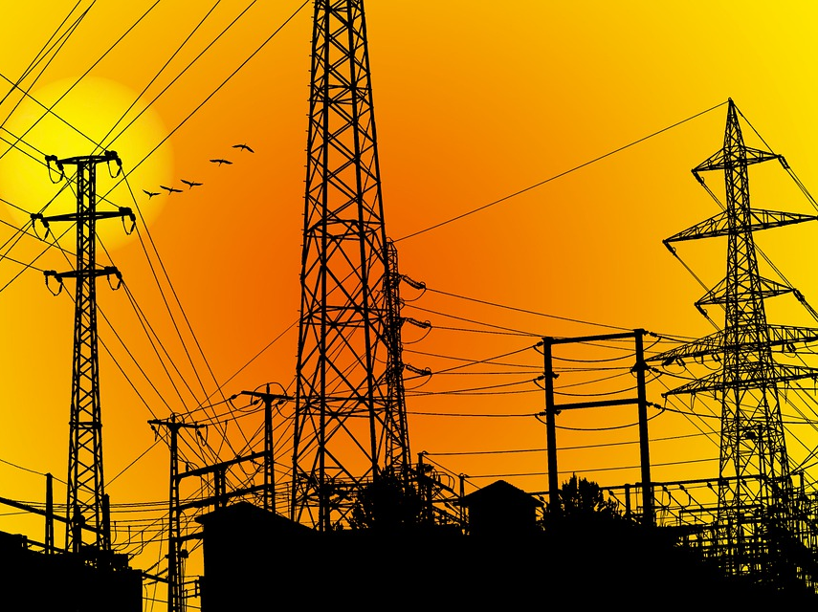
Ukraine
2015 / 2016
Notes:
Ukraine 2015
Functions Provided:
Three distribution companies managed roughly 53 substations to provide power for their respective service areas in Ukraine.
Security Mindset:
Prior to this event, there had not been an electric grid attack conducted via cyber means.
The SCADA and distribution management platforms were considered separate from the business network, and less accessible.
High Consequence Event:
225,000 customers experienced power outages.
Approximately 180 servers and workstations were taken offline.
Load impact of 135 MW.
Sabotage Effect:
The attackers caused outages by using the engineered functionality of the controls platforms to manipulate circuit breakers within the substations.
Attackers also prevented an immediate restoration of normal power delivery by targeting core supporting functions of centralized control: field communications (altered firmware uploaded to station Serial-to-Ethernet gateway devices) and operator visibility (“wiping” hard drives of operator workstations and servers).
Malicious modifications to uninterruptable power supply (UPS) configurations were also discovered. Attack preparation involved first gaining access to the companies’ business networks (via spear phishing), harvesting credentials and escalating privileges, and using the stolen, trusted ICS accounts for remote VPN access to the power system networks.
Lesson Learned:
Having the ability to return to manual control is very important.
Ukraine 2016
Functions Provided:
Power transmission near the nation’s capital.
Security Mindset:
Fresh from 2015’s attack just one year prior, the Ukrainian grid was known to still be vulnerable.
Recovery from the previous attack was still ongoing.
High Consequence Event:
A blackout affecting an even larger population than the 2015 attack occurred in Kiev, Ukraine.
Several protective relays were rendered useless.
Sabotage Effect:
Devices were rendered useless.
Lack of system integrity confidence.
Lesson Learned:
The deep understanding of the adversary, and the way the interacted with the field devices shows a major advancement over the previous attack.
The attack could have been much worse based on the type of physical damage the malware was intended to cause.
Image Source: https://pixabay.com/illustrations/electricity-electrical-energy-5066143/

Slide 17
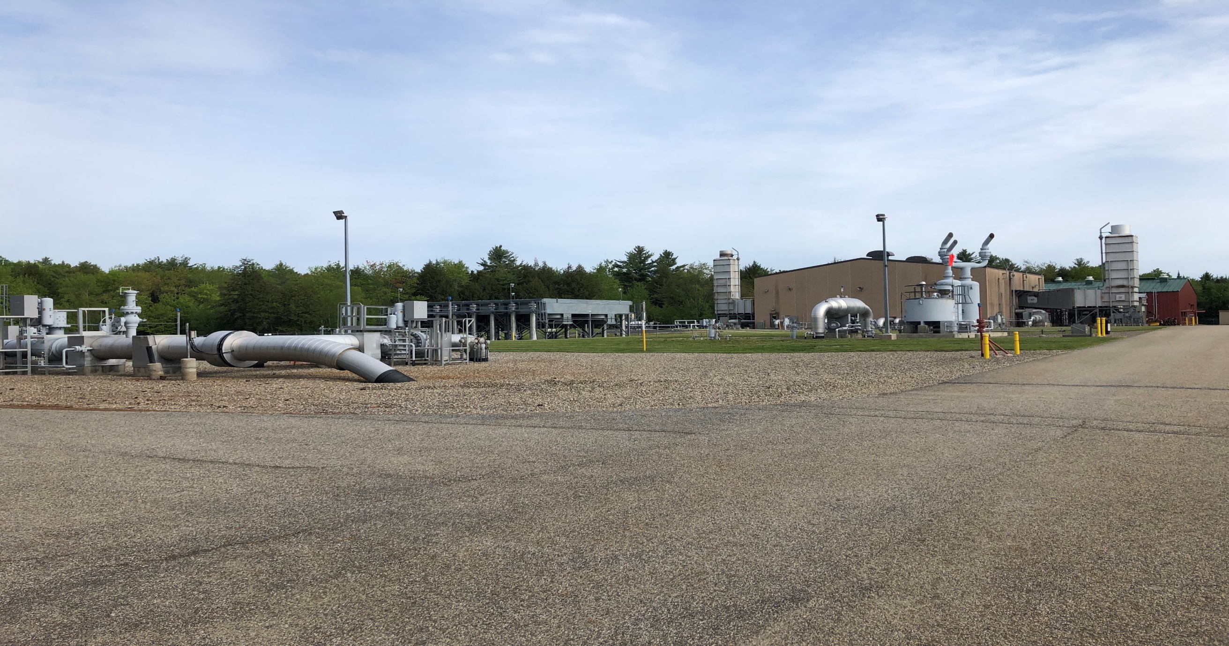
Typical Natural Gas Compressor Station
Attributes
Increase pressure and speed of gas
Monitor pressure of pipeline
Highly complex equipment
Applications/Devices
SCADA
HMI/PLC/RTU
Workhorse of the system and critical for maintaining deliveries.

Slide 18
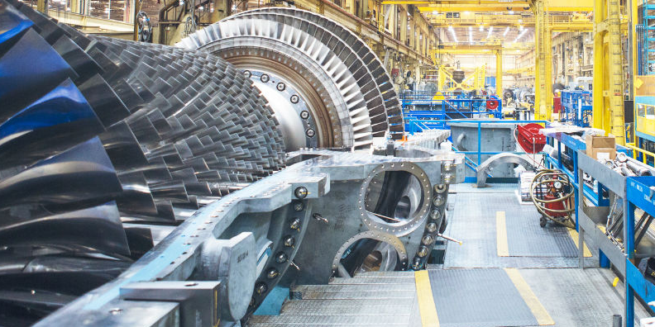
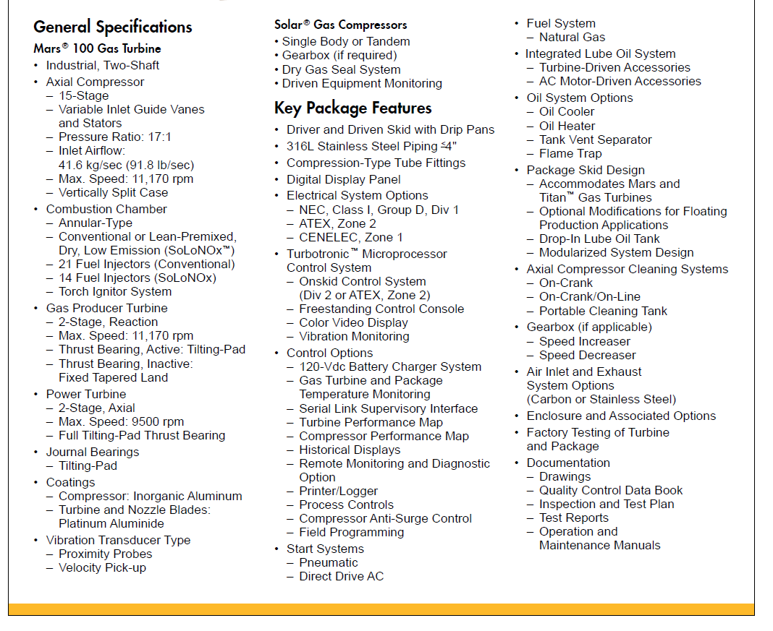
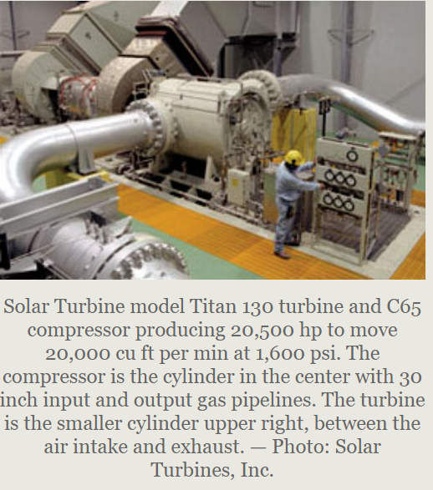
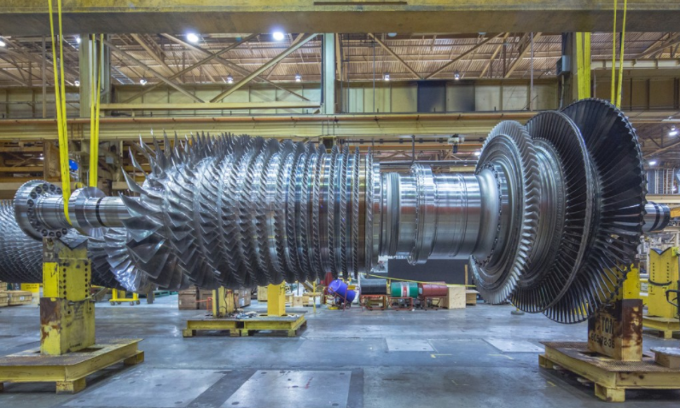
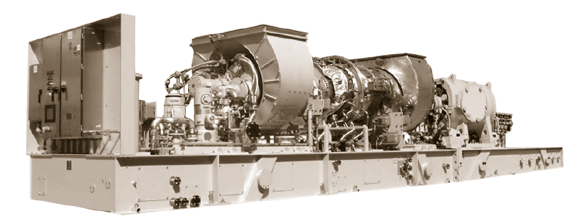
Natural Gas Transmission: Gas Turbine Compression
How do they do that? How do they provide compression? What does that look like….
The “compressor unit” (engine and compressor bodies) is the star of the show: the physics and chemistry harnessed here are based on the Brayton Thermodynamic Cycle named after George Brayton, which describes the workings of a constant-pressure heat engine. The original Brayton engines used a piston compressor and piston expander, but more modern gas turbine engines and airbreathing jet engines also follow the Brayton cycle.
The Brayton cycle (or Joule cycle) consists of four processes:
a - b Adiabatic, quasi-static (or reversible) compression in the inlet and compressor;
b - c Constant pressure fuel combustion (idealized as constant pressure heat addition);
c - d Adiabatic, quasi-static (or reversible) expansion in the turbine and exhaust nozzle, with which we take some work out and use it to drive the air compressor and take the remaining work out and use it to accelerate fluid for jet propulsion, or to drive a gas compressor.
d - a Cool the air at constant pressure back to its initial condition.
Notes:
Based on my experience as an automation engr…. Based on my experience in ICS security consulting….
Brayton Cycle
https://en.wikipedia.org/wiki/Brayton_cycle
https://web.mit.edu/16.unified/www/SPRING/propulsion/notes/node27.html
Gas Turbine Compressor Cycle
https://www.researchgate.net/figure/Single-shaft-and-twin-shaft-gas-turbines_fig1_333018892
Solar Gas Turbine Compressor Skid
Solar Turbines – Mars 100 Datasheet
GE Compressor and Turbine Blades
https://www.designworldonline.com/photos-of-the-day-an-inside-look-at-a-ges-gas-turbine-plant/
Compressor Station P&ID Image
https://www.chegg.com/homework-help/questions-and-answers/given-pfd-s-natural-gas-compression-process-needs-transfer-block-flow-diagram-process-than-q25358616

Slide 19
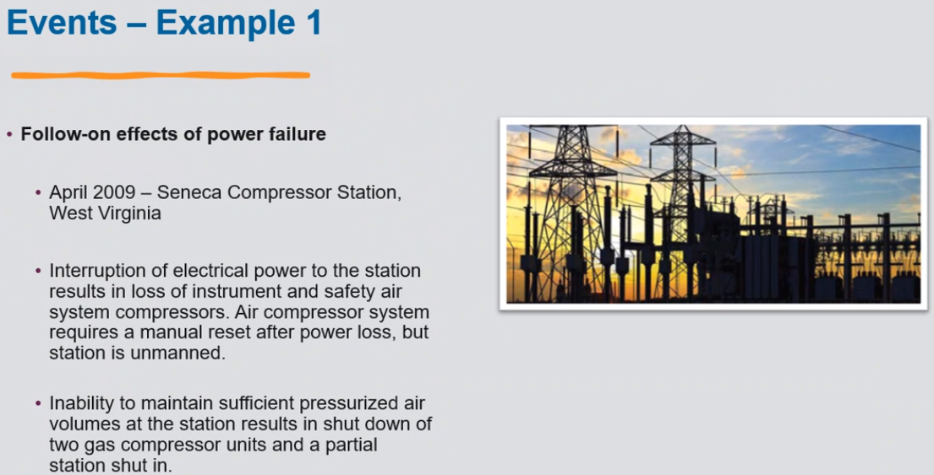

Slide 20
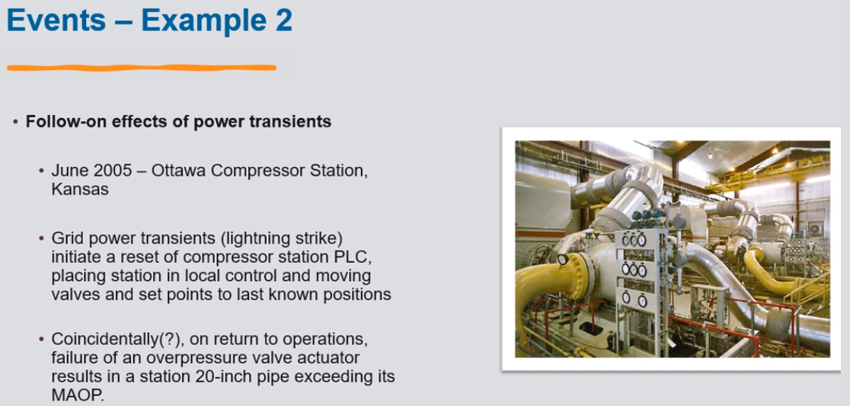

Slide 21
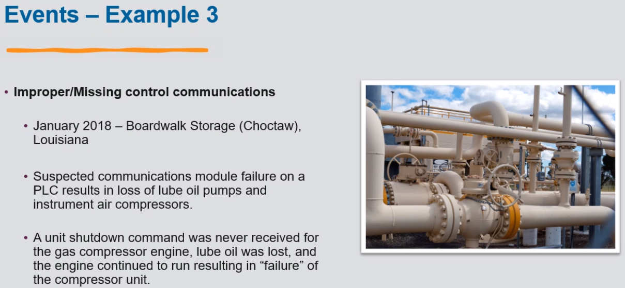

Slide 22
Vehicles for Cyber-enabled Sabotage
Cyber threat actors have an extensive collection of tools, methods, and resources to launch cyber attacks against enterprises.

Slide 23



Misuse of Technology
Misuse of technology WILL IMPACT your Critical Functions.
Often, adversaries can manipulate existing systems and processes without creating new payloads or malware to carry out an attack.
Attack Requirements
Force a firmware update
Stop charging batteries
Open Breakers
Delete Backups
Existing Capabilities
Maintenance Mode
Battery charge scheduler
Substation remote HMI
Backup files stored on
network
Notes:
If an adversary correctly understands the relationships between the people, processes, and technology used to perform Critical Functions, a bad actor can misuse existing technology to carry out cyber-enabled sabotage.

Slide 24


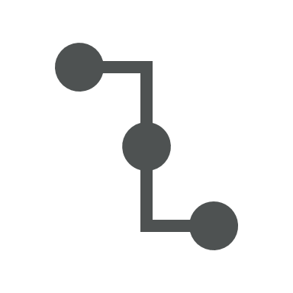


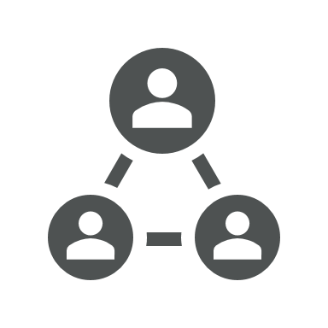




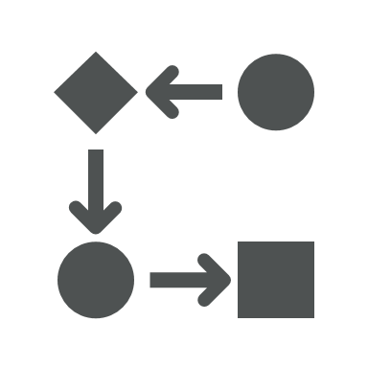

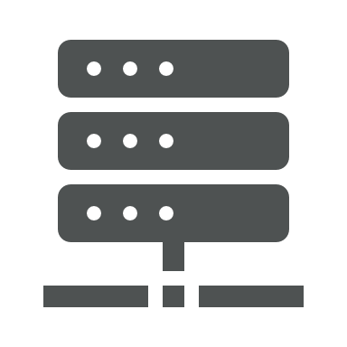

Unverified Trust
Cloud data vendor – how much access?
Who can access what?
Who accesses data from where?
Current process audited?
Firmware updates process and schedule?
Software updates process and schedule?
Subcontracted operators?
Employee backgrounds?
Subcontracted technicians?
Third-party printing services?
Who has access during compliance checks?
Supply chain?
Maintenance and support vendors?
Notes:
All icons from PowerPoint built-in icon finder.
We all have some degree of unverified trust in our people, processes, systems, and technology, but we often fail to consider targeted misuse of one or more of these. We need to break the established trust model and accept that an adversary will target our CFs.
The adversary will focus on leveraging “unverified trust” in our delivery (in our EF) and that the implementation of our systems, PPT, operations, and support may present unnecessary and possibly unacknowledged risk to this CF delivery.
Engineered Connectivity
Controls/monitoring platforms (device to device, across functions, across processes)
Communications infrastructure (common vendor platform – enterprise or field comms)
Asset management platforms (e.g., SolarWinds)
Security/vulnerability management platforms
OS/application patching platforms
Vendor systems support (PLCs, VFDs, Vibration, IIoT networks/devices, etc.)
Remote ops support – (e.g., Oldsmar water treatment in FL, TeamViewer)
Operational Support
Local ops support – common device used to support “trusted” and “untrusted” network devices (e.g. OT and IIoT)
Network config/internal ops – personnel/device access to external networks
Application Development
Vendor code repositories (e.g., “dependency confusion” attack demo)
Unless you have directly seen how a third-party vendor handles your data and equipment, you are assuming a certain level of unverified trust. Once identified, you either assume this risk or eliminate the unverified trust by examining processes in detail.
EXAMPLE: if you’re in manufacturing Critical Infrastructure sector, and you’re heavily invested in Rockwell software, a SolarWinds-type attack compromising Rockwell applications means everything in the facility could be affected.
Take away: You need to be able to answer the question “What does this mean? What is the potential impact?"

Slide 25
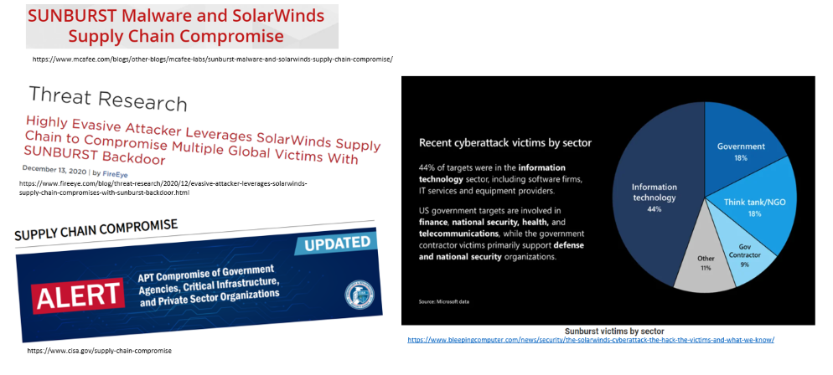
SolarWinds Supply Chain Attack
Notes:
Instructor’s note: discuss how SolarWinds (or any network-based service) compromise can permeate a variety of critical infrastructure organizations.
Marketing/reporting data for food and food services manufacturer (or paper product company like P&G responsible for baby wipes, diapers, and toilet paper)
Ability to provide patient care or surgeries for health and healthcare services sector
Ability to accurately distribute and bill products for a pharmaceutical organization
Security in communication for telecom/communications provider
Ability to accurately bill and meter kWh for a utility company
Rail-based transportation company can’t transport goods if wayside instrumentation and control devices are compromised
Pump control for ONG sector

Slide 26
What is the Solution?

Slide 27
Defender’s Advantage
The adversary will always know at least as much as you do about your technology―maybe even more.
But they won’t always know how you use your technology to deliver a critical function.

Slide 28
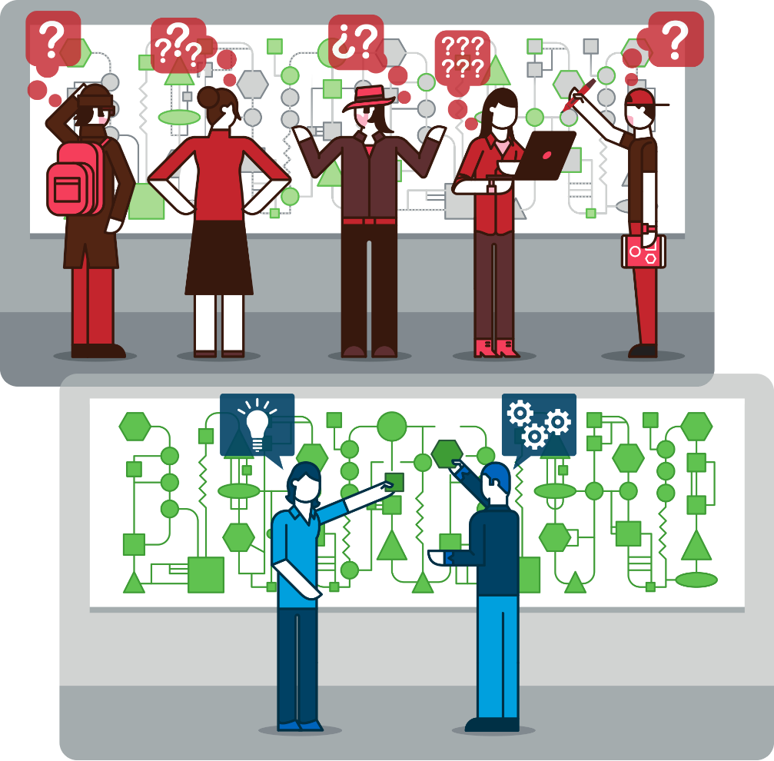
Perfect Knowledge
The understanding of how a critical function is uniquely implemented at an organization.

Slide 29
Consequence-driven Cyber-informed Engineering
Methodology that guides organizations in identifying and mitigating catastrophic effects resulting from cyber-enabled sabotage.

Slide 30
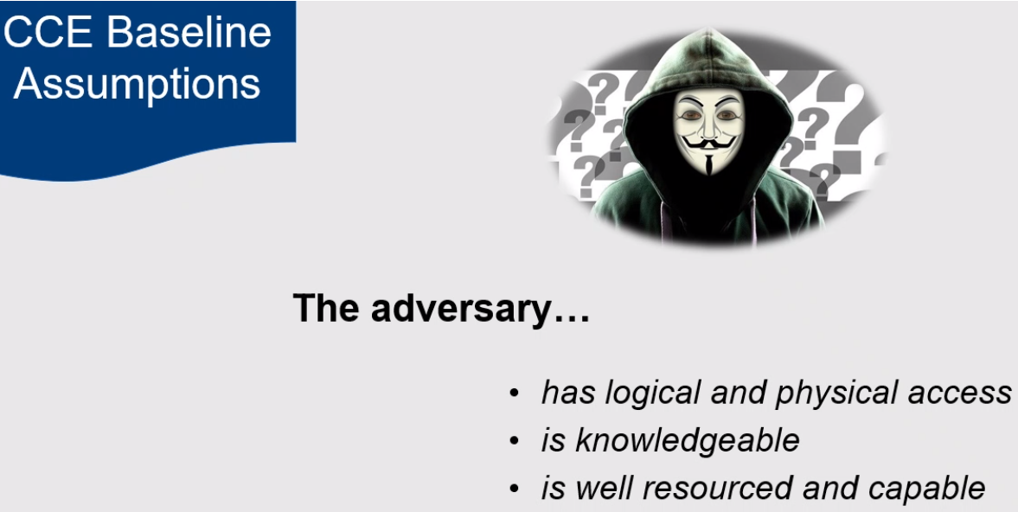

Slide 31
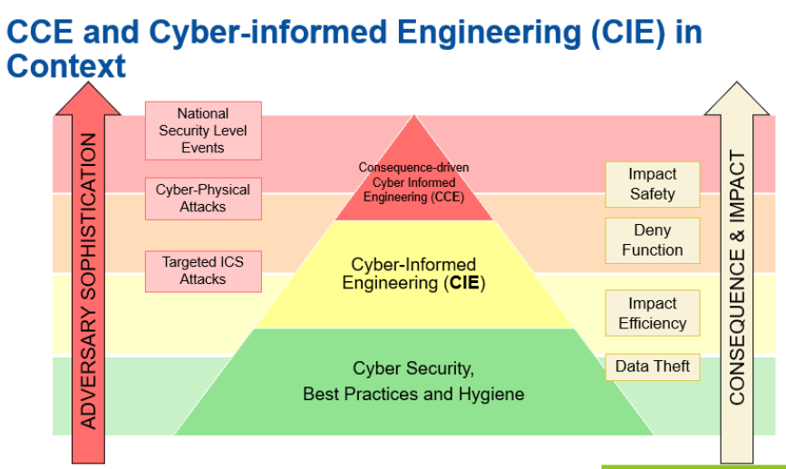

Slide 32
CCE Overview
The goal of CCE is to protect critical functions from existing and emerging threats and proactively prepare for the next generation of cyber-enabled sabotage.
Notes:
Approach: Consequence based Cyber Defense Engineering (CCE: Consequence based Cyber Engineering)
CCE is based on business's consequences and then looking at what adversary can do to affect that consequence.
Take the mind set of Adversary, on what critical areas they would like to impact. What are the high consequence event (HCE) adversaries need to perpetrate.
HCE: Blast radius
CCE only works if all 4 phases are completed

Slide 33
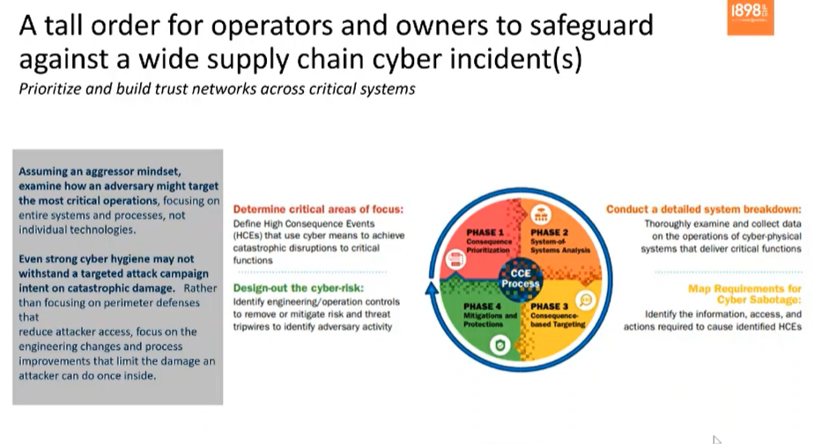

Slide 34
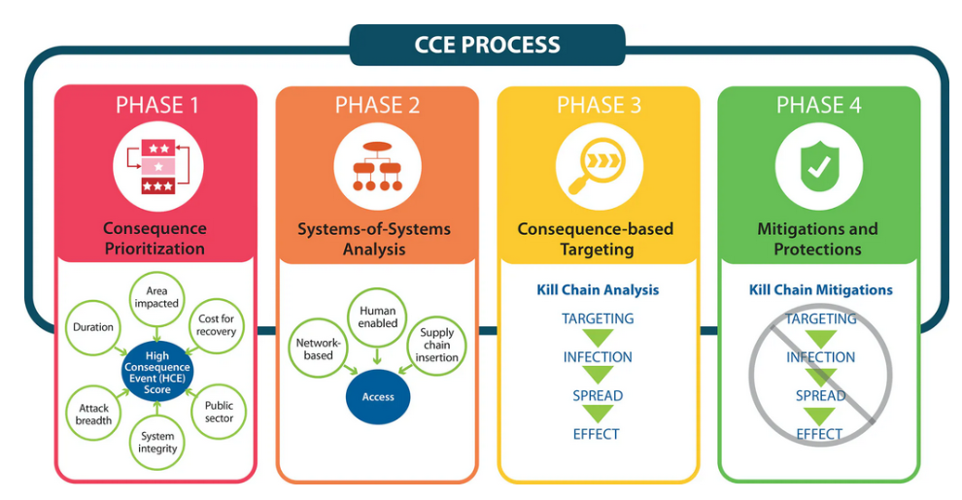

Slide 35
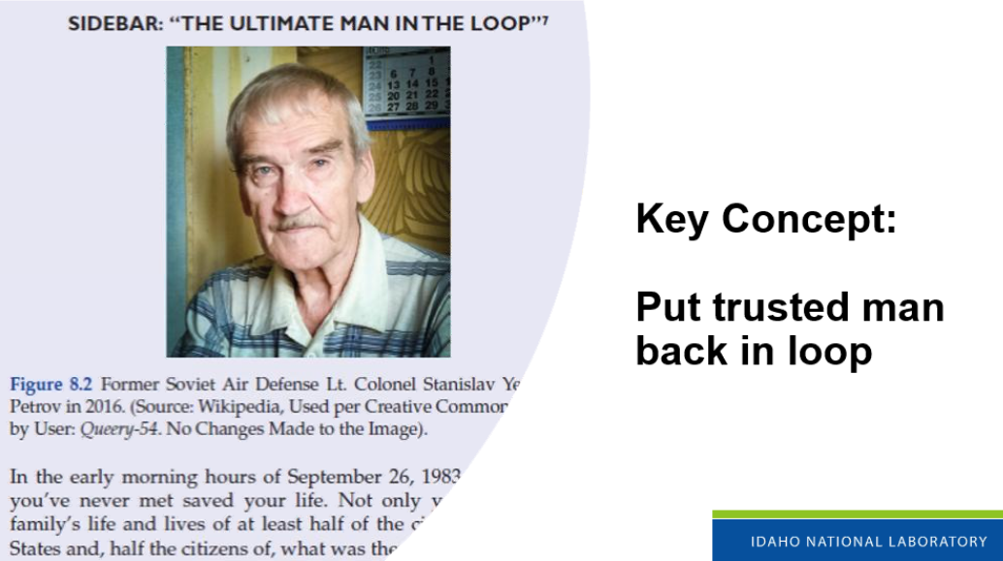

Slide 36
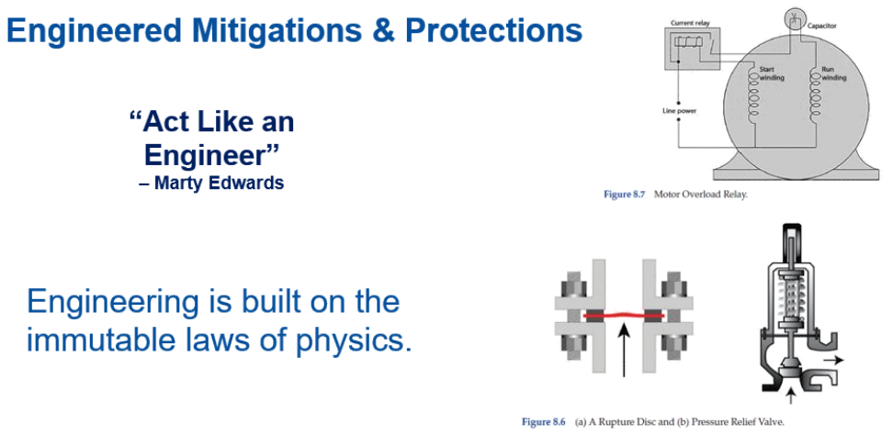
Notes:
Think like an Adversary but act like an Engineer
Cyber Defenses can be best enacted if you take an engineering mindset

Slide 37
Summary
Key Concepts
The adversary is targeting critical functions and how we deliver them.
Don’t blindly trust everything!
The adversary may know what your systems are, but not necessarily how they are uniquely implemented in your organization.
We have advantages that take the adversary years to acquire.
Always protect your data!
Key Terms
CCE
Critical Functions
Cyber-Enabled Sabotage
Unverified Trust
Perfect Knowledge
Data Protection

Slide 38

Questions

